Slide 1


Predictive Velocity Obstacle Method for Mobile Robot Motion Planning Among Dynamic Obstacles with Unknown Intentions

Slide 2
Introduction
Methods
Results
Discussion

Slide 3
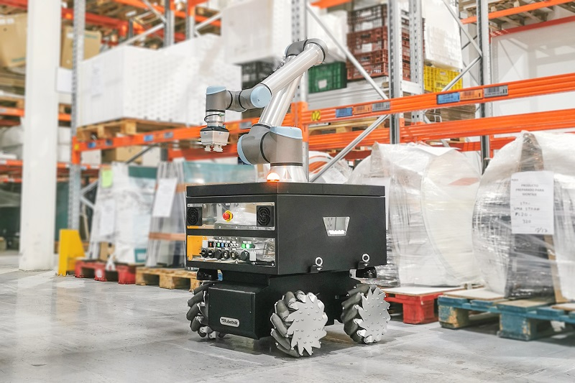
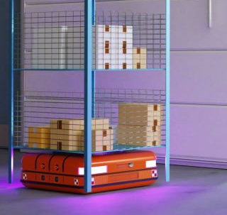
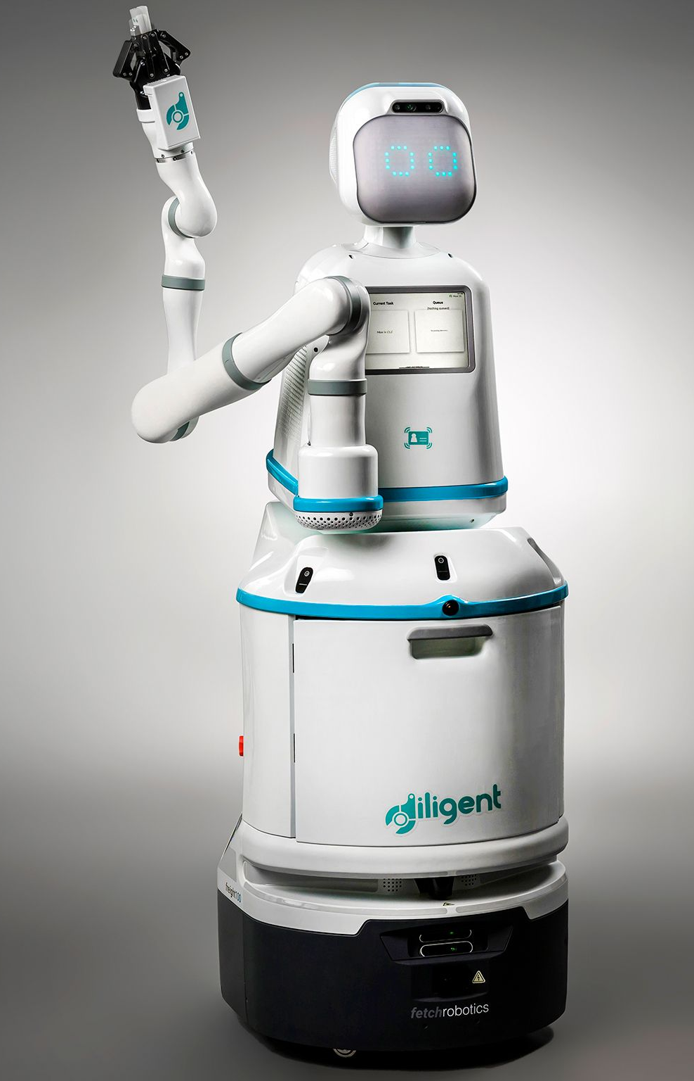


Autonomous Mobile Robots (AMR)
Motion Planning
Introduction
Methods
Results
Discussion

Slide 4
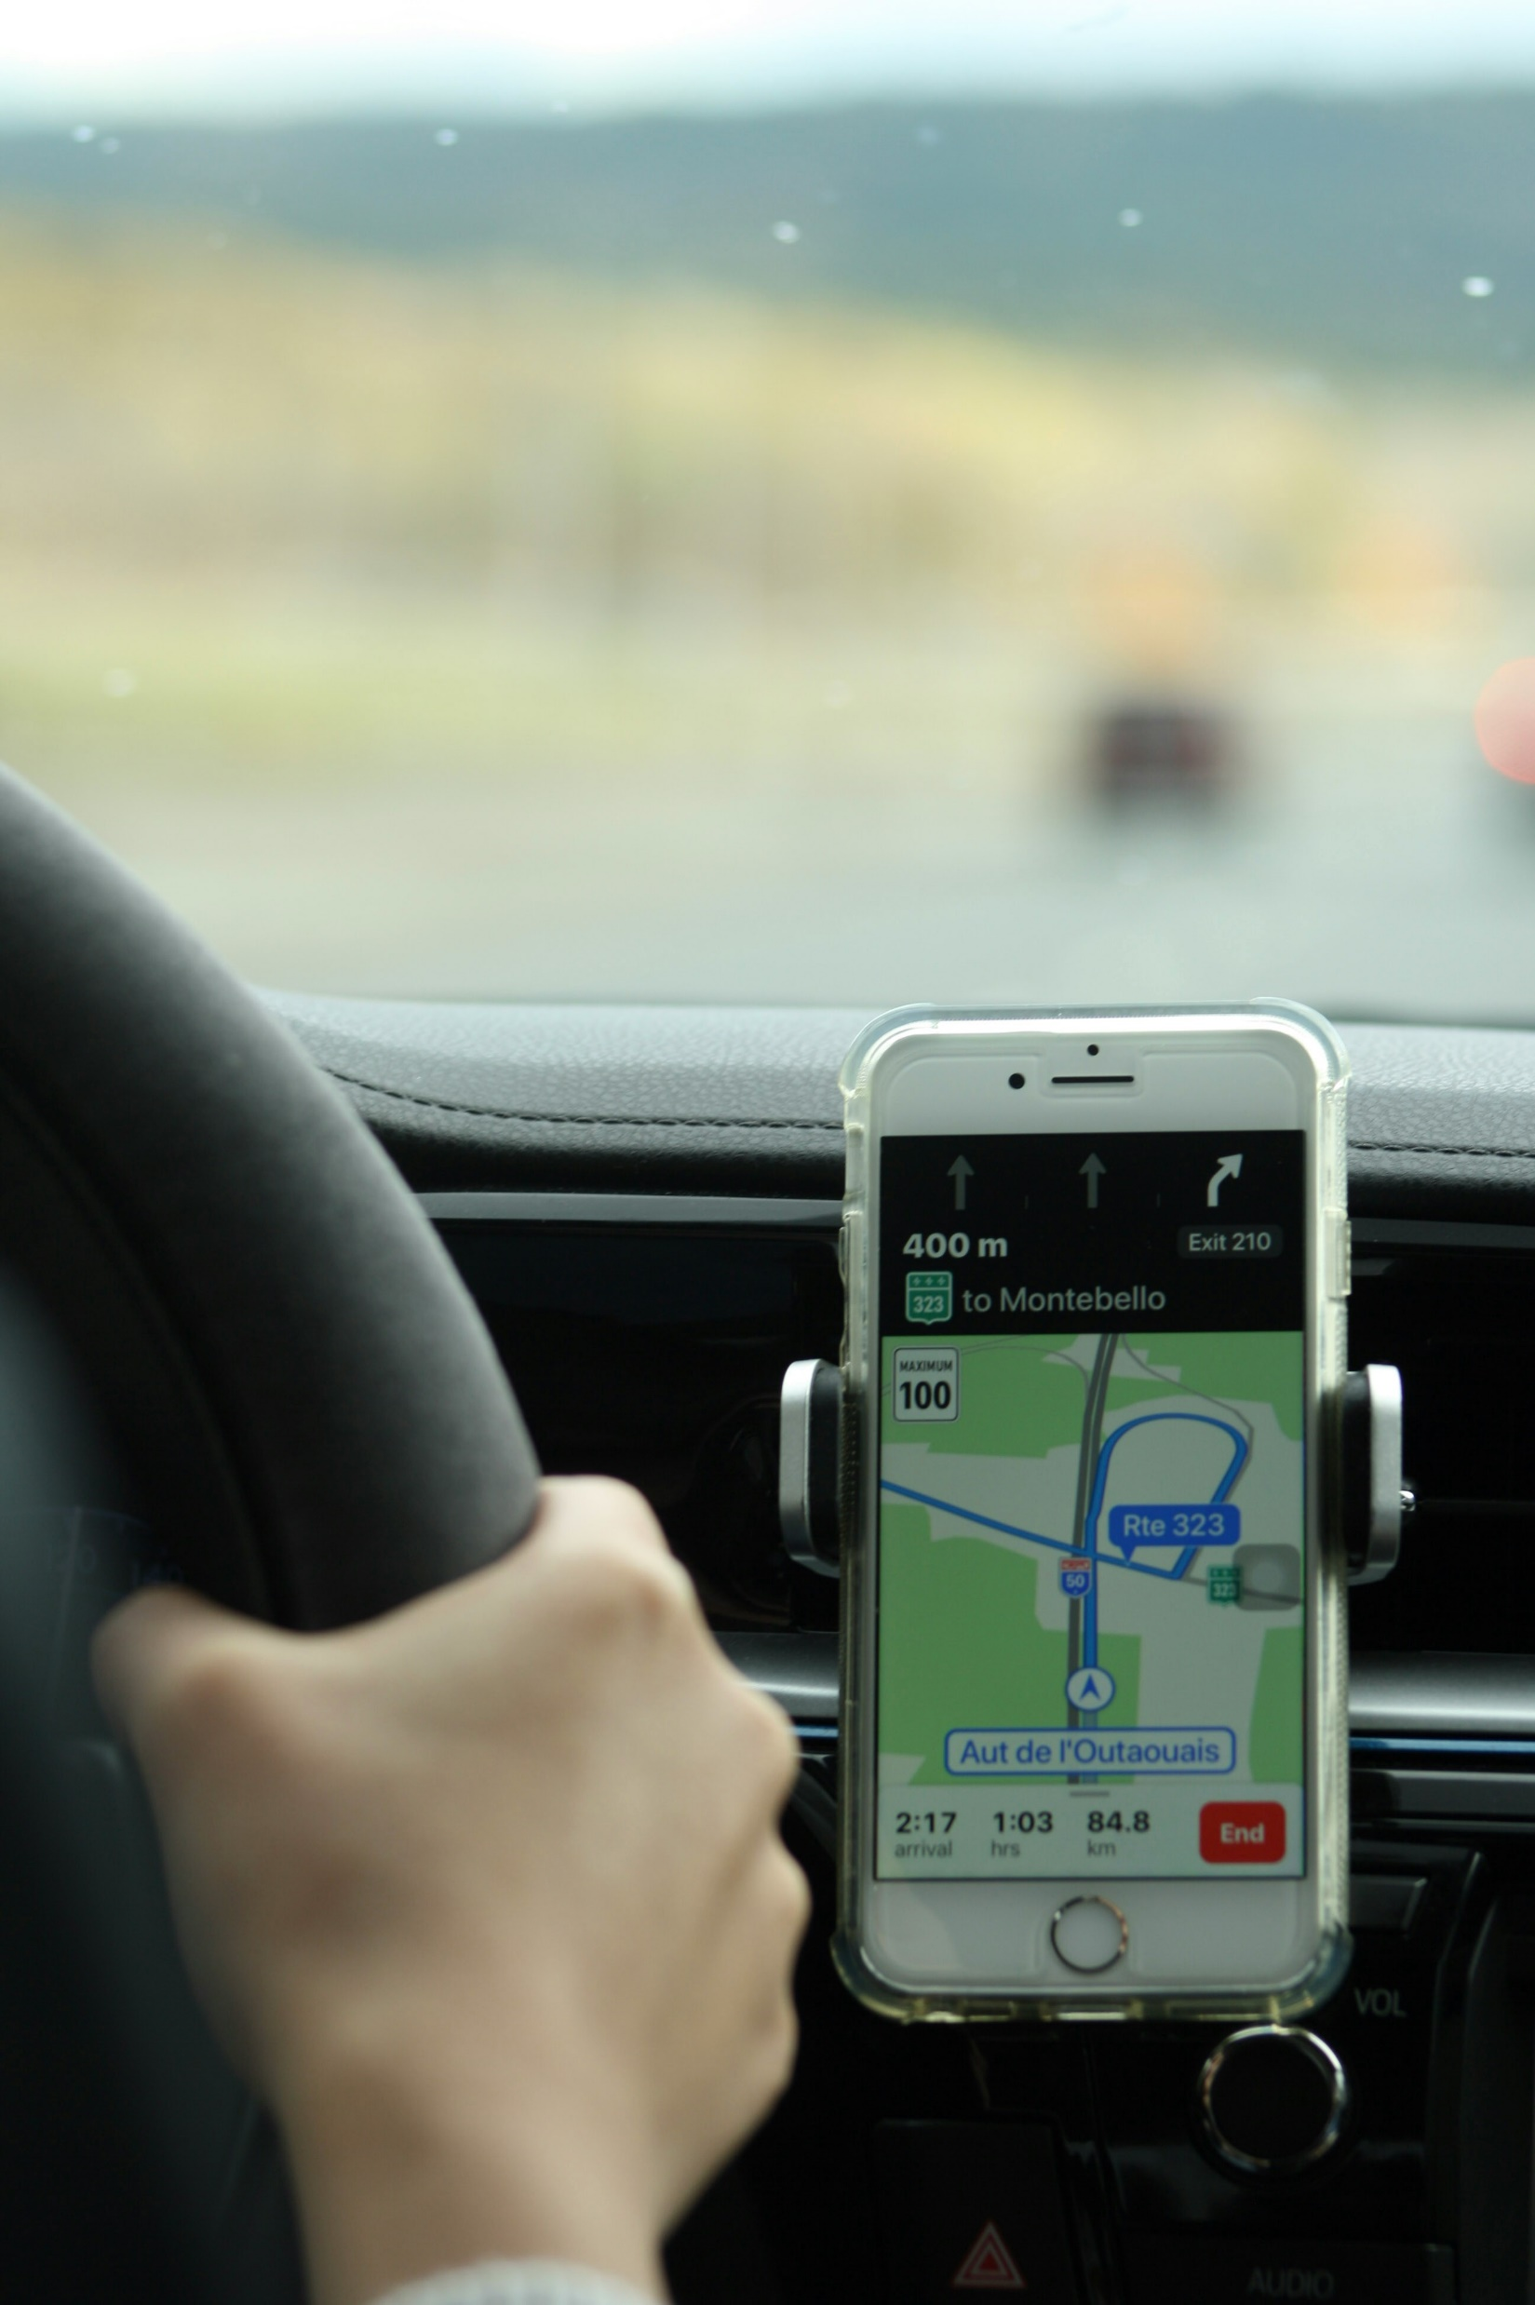
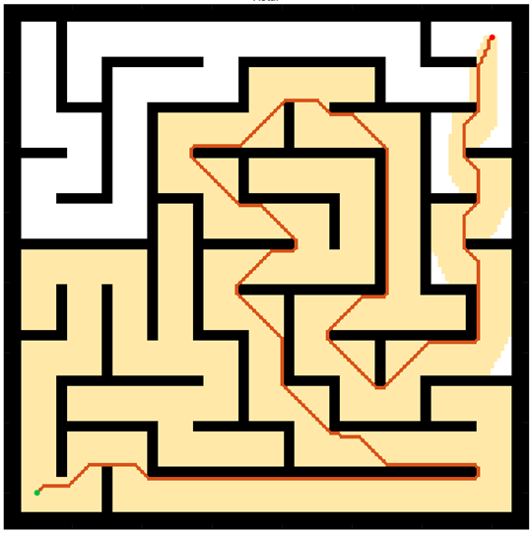
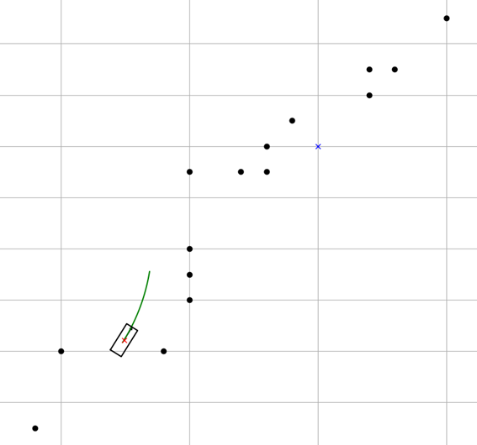
Motion Planning
Motion Planning finds a continuous sequence of valid configurations that safely and efficiently guide a robot from start to goal.
Global Planning
Navigation
Avoiding Static obstacle
Local Planning
Handle emergency
Evading moving objects
Google Map
Global Planning
Driver
Local Planning
Introduction
Methods
Results
Discussion

Slide 5
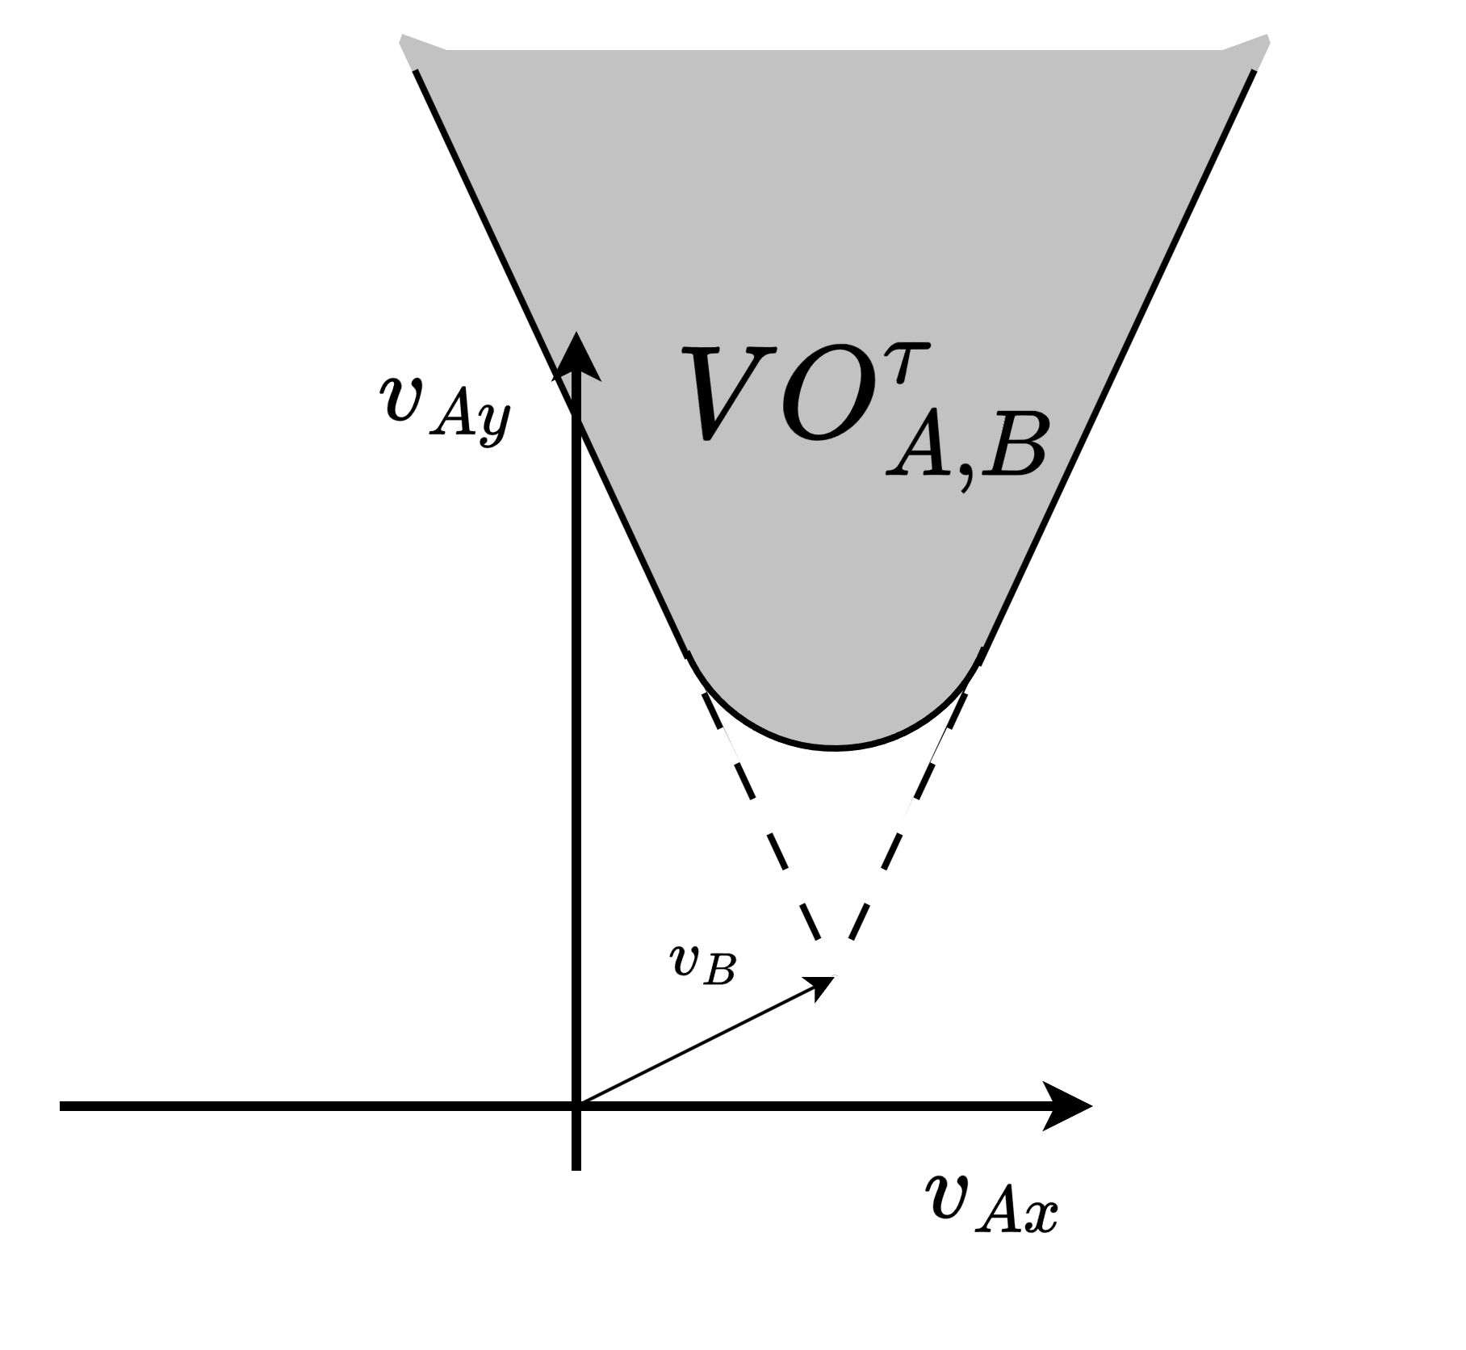
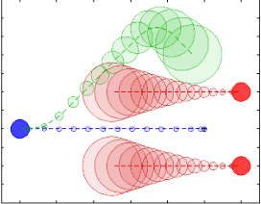
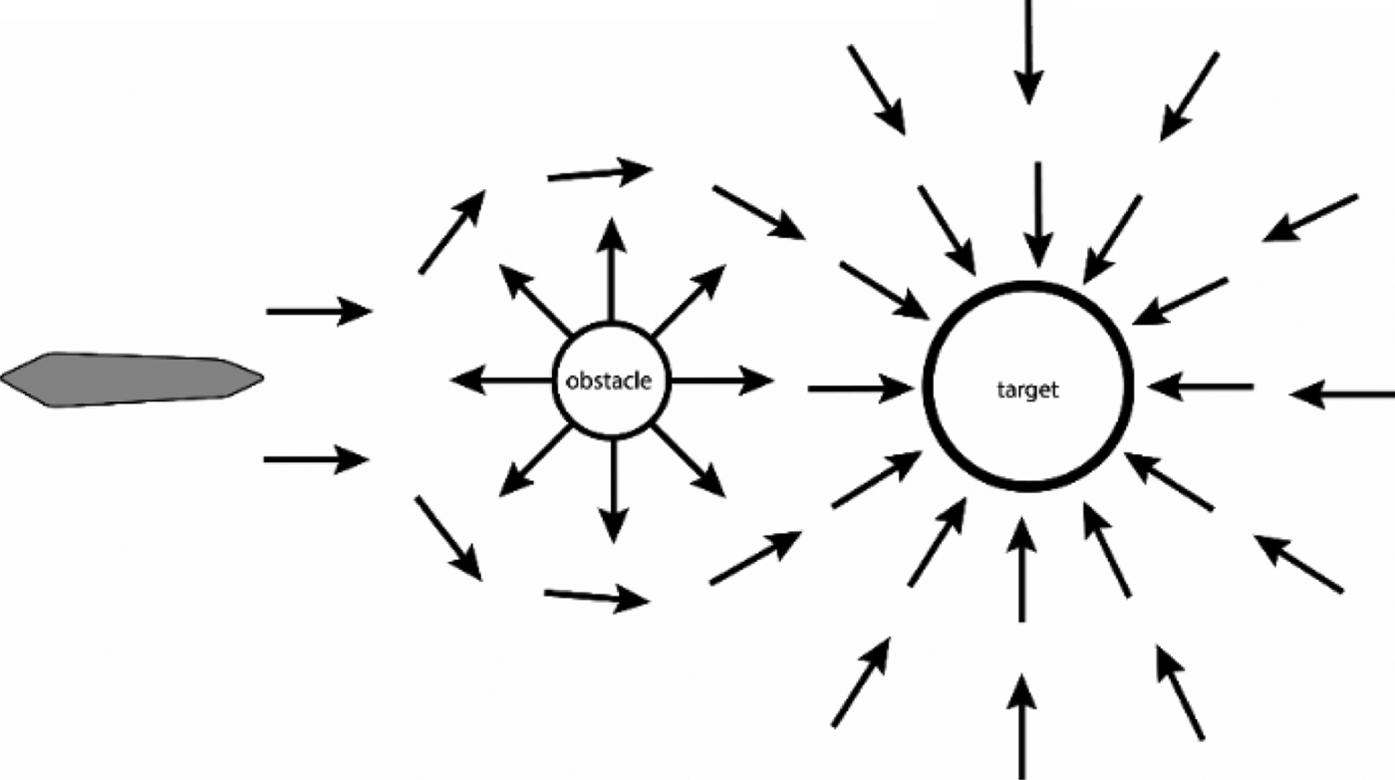
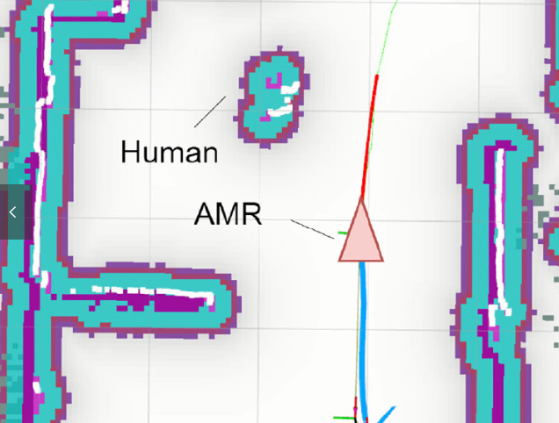
Local Planning
[1] Polvara, Riccardo, et al. "Obstacle avoidance approaches for autonomous navigation of unmanned surface vehicles." The Journal of Navigation 71.1 (2018): 241-256.
[3] Du Toit, N. E. and J. W. Burdick (2010). Robotic motion planning in dynamic, cluttered, uncertain environments. 2010 IEEE International Conference on Robotics and Automation, IEEE.
[2] Wu, C.-H. and K.-Y. Chan (2024). "Developing a dynamic obstacle avoidance system for autonomous mobile robots using Bayesian optimization and object tracking: Implementation and testing." Proceedings of the Institution of Mechanical Engineers, Part C: Journal of Mechanical Engineering Science 238(9): 4007-4022.
Artificial Potential Fields (APF) | Dynamic Window Approach (DWA) | Velocity Obstacles (VO) | Model Predictive Control (MPC)
Simple for real-time avoidance | Effective, Dynamic feasible | Deal with multi-agents systems | Handles robot dynamics
Local minima issue | Struggle with moving obstacles | Poor to handle unknow intension | Computationally expensive
[1]
[3]
[2]
former lab members’ research
My research want to use
Introduction
Methods
Results
Discussion

Slide 6
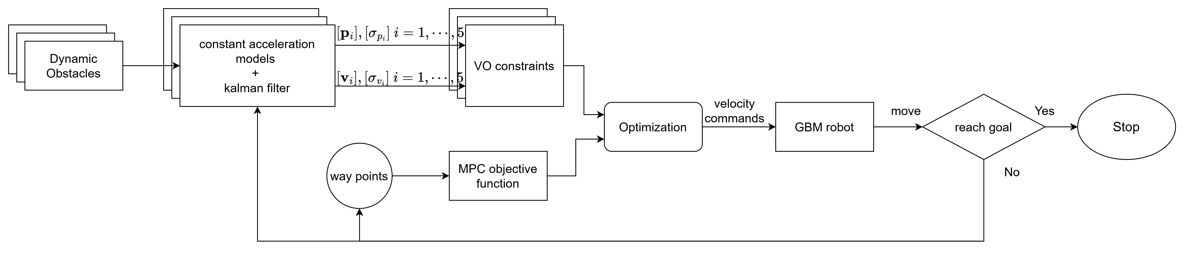
Structure
Prediction step
Optimization step
Introduction
Methods
Results
Discussion

Slide 7
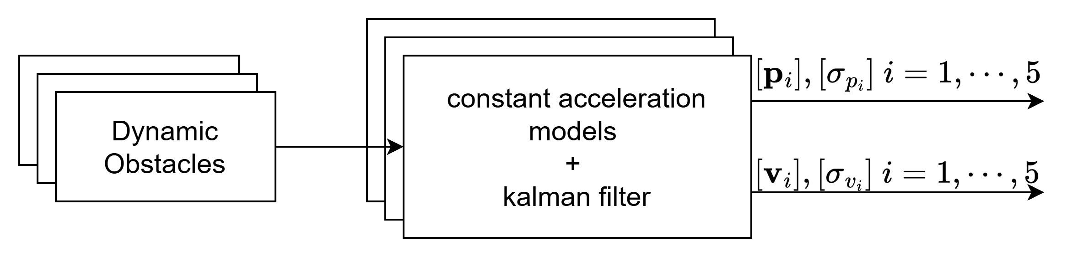

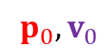
Prediction step
Prediction step
Prediction
$$p_{i},v_{i}, i=1,2,3…$$
$$p_{0},v_{0}$$
Observation
Constant Acceleration Model
Dynamic Obstacle
Prediction by Kalman Filter
Introduction
Methods
Results
Discussion

Slide 8
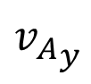
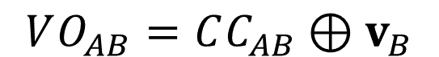
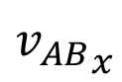
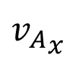
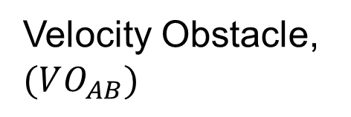
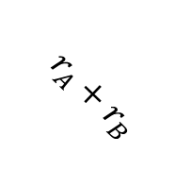
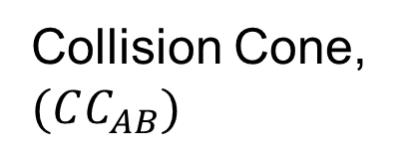
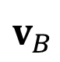
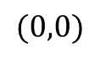
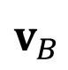
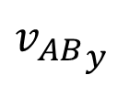
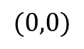
Velocity Obstacle (VO)
$$VO_{AB}=CC_{AB}⊕v_{B}$$
C-space
Velocity space
$${v_{AB}}_{y}$$
$${v_{A}}_{y}$$
Collision Cone, $(CC_{AB})$
Velocity Obstacle, $(VO_{AB})$
$$v_{B}$$
$$r_{A}+r_{B}$$
object B
$${v_{AB}}_{x}$$
$${v_{A}}_{x}$$
$$(0,0)$$
$$(0,0)$$
$$v_{B}$$
agent A
Introduction
Methods
Results
Discussion

Slide 9
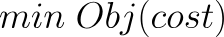
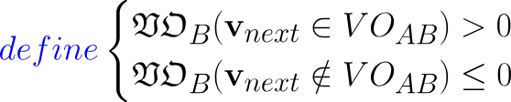
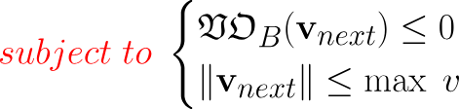
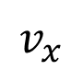

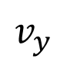
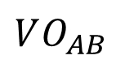
Conventional VO method
Design variables: $v_{next}$
Velocity space
$$v_{y}$$
$$VO_{AB}$$
Dynamic feasible region
Ideal velocity
$$v_{x}$$
Introduction
Methods
Results
Discussion

Slide 10
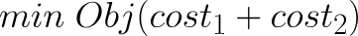
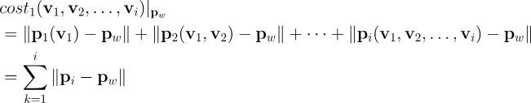
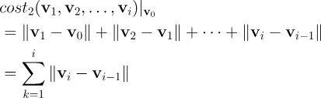
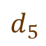

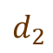

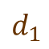
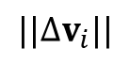
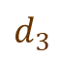
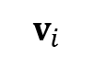
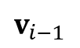
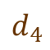
Expand VO method
Design variables: $v_{1},v_{2},v_{3},…,v_{i}$
Way point distances
Way point${ p}_{w}$
Way point distances
Change amount of velocity
$$d_{5}$$
$$d_{4}$$
$${||∆v}_{i}||$$
$$d_{3}$$
$$d_{2}$$
$$v_{i}$$
$$v_{i−1}$$
$$d_{1}$$
Change amount of velocities
Robot
Velocity space
Introduction
Methods
Results
Discussion

Slide 11
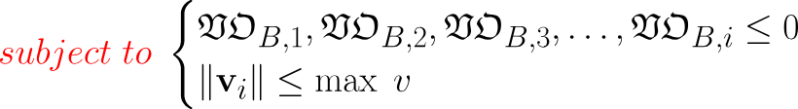
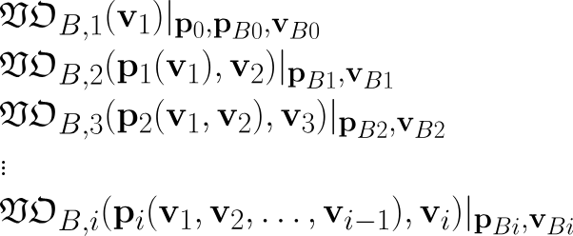
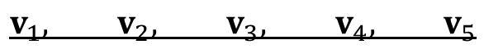
Expand VO method
Design variables: $v_{1},v_{2},v_{3},…,v_{i}$
Constraints:
Constraints:
$$v_{1}, v_{2}, v_{3}, v_{4}, v_{5}$$
Design variables
Constraints:
Constraints:
Constraints:
Introduction
Methods
Results
Discussion

Slide 12
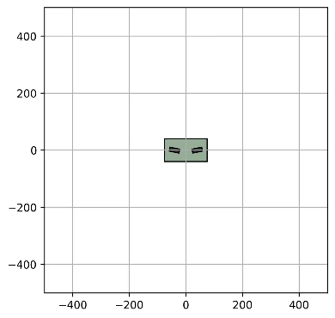
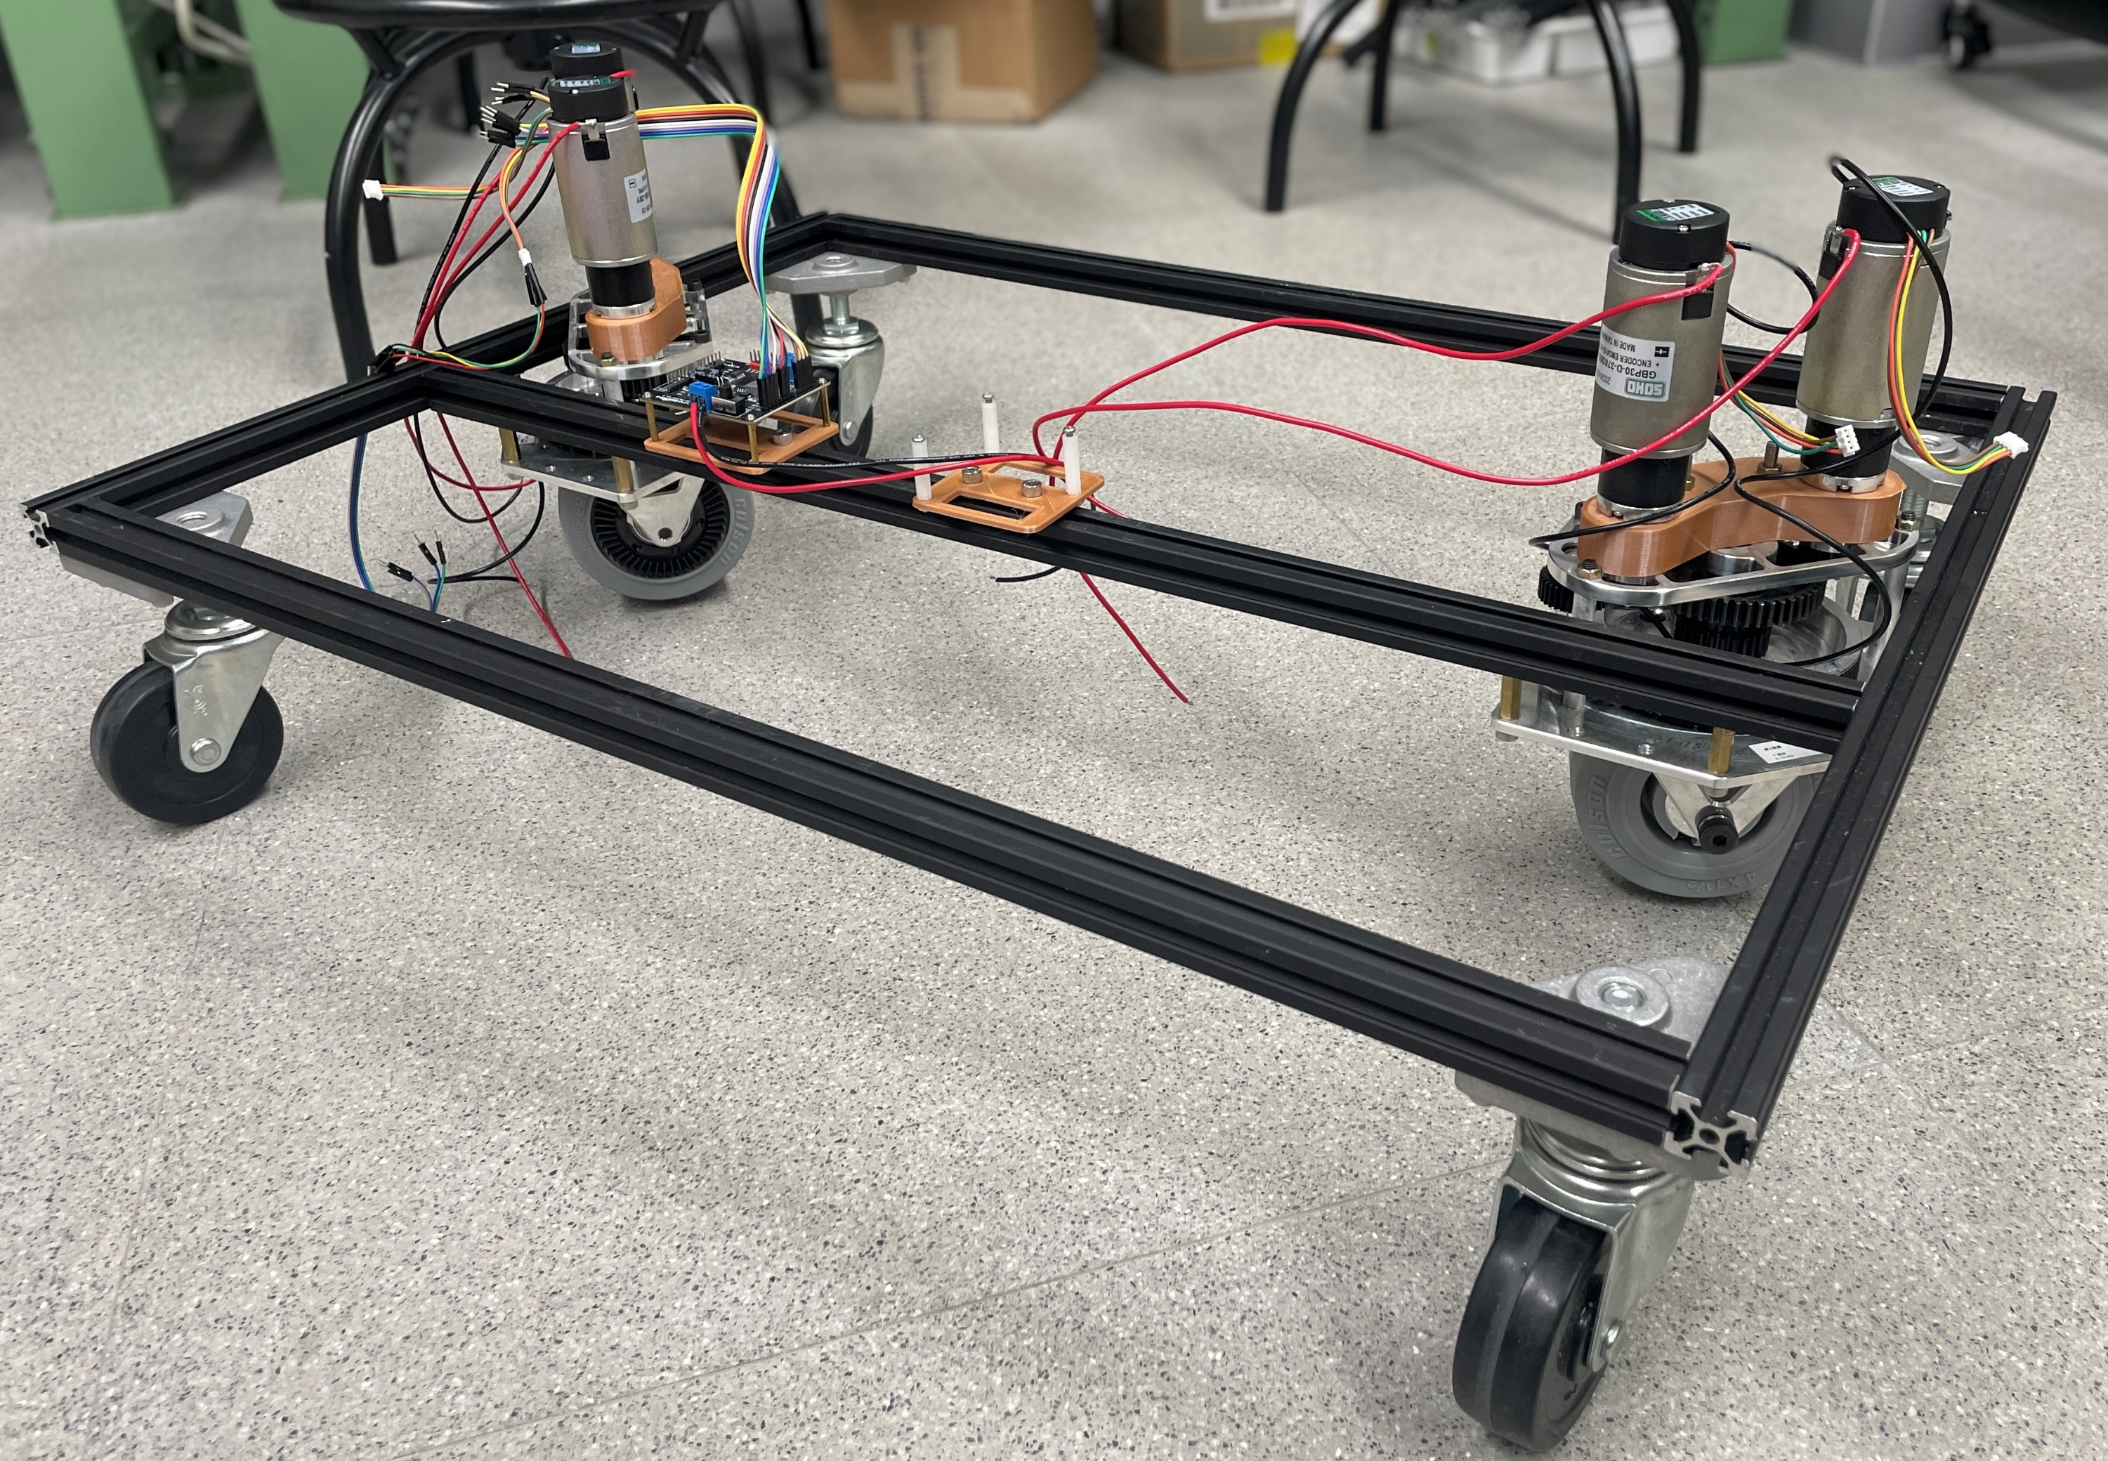
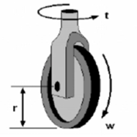
Tested AMR
Generalized Bicycle Model
Holonomic robot (heading and orientation are decoupled)
2 wheels that can rotate and spin independently
rotate
rear wheel
Front wheel
spin
Introduction
Methods
Results
Discussion

Slide 13
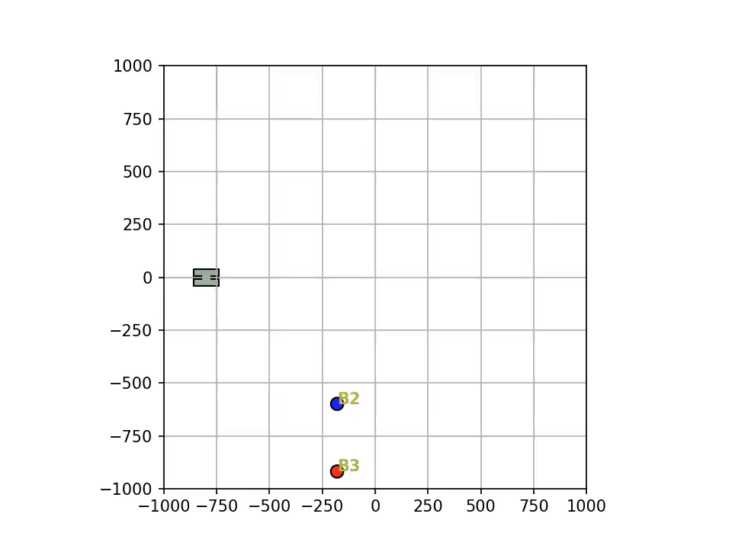

Simulation Result
method | Conventional VO | Expanded VO
collision | Collide | safe
Reach time | 19.98 second | 16.84 second
Introduction
Methods
Results
Discussion

Slide 14
Discussion
Contribution
Introduction
Methods
Results
Discussion

Slide 15
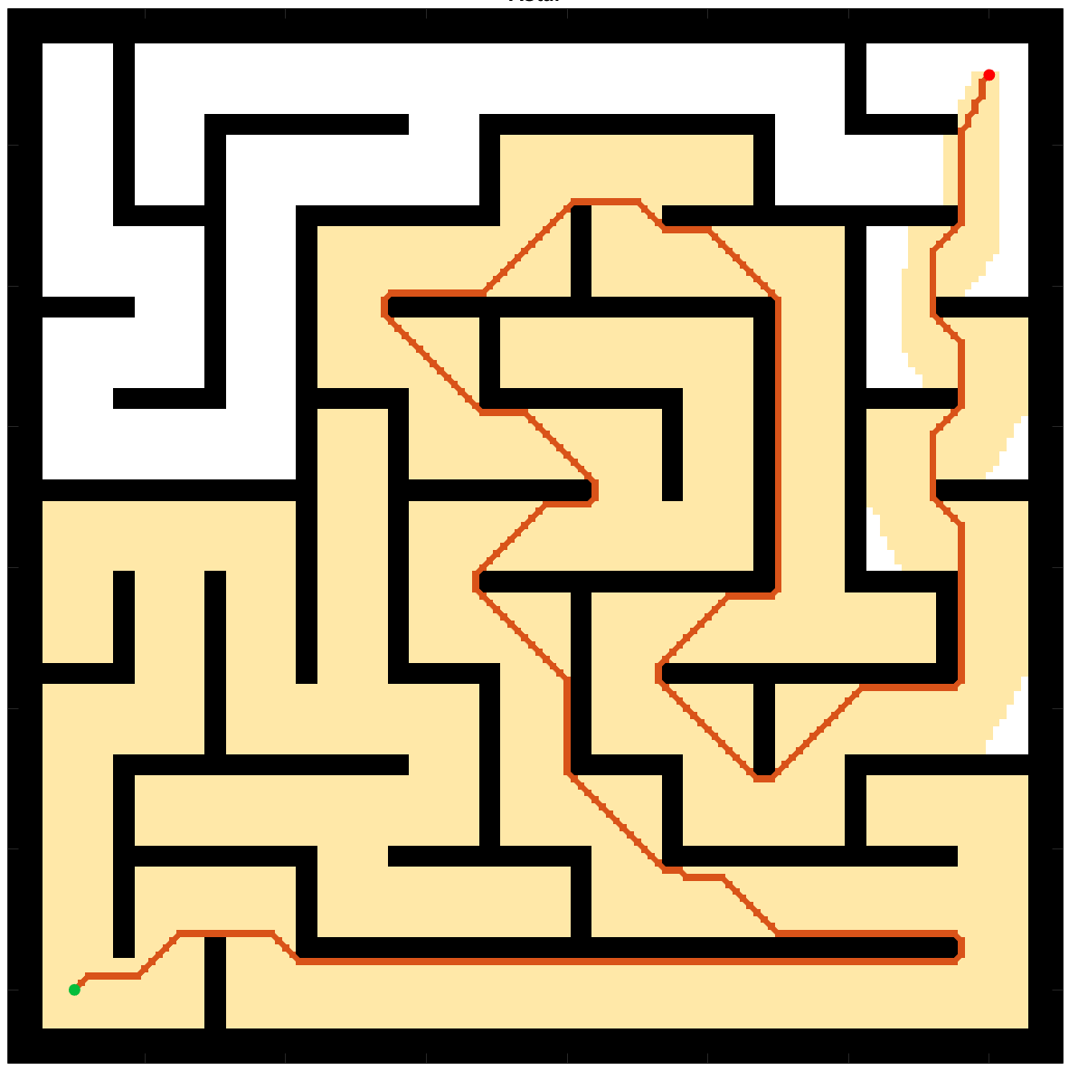

Introduction of Path Planning
B
A
Global Planning
Local Planning
Introduction
Methods
Results
Discussion

Slide 16







Optimization step
Minimize
Way point distances
Objective Function (design variable: $v_{i}, i=1,2,3…$)
= ∑ way point distances + ∑ change amount of velocity
Subjected to:
Velocity Obstacles
Way point
Change amount of velocity
$$d_{5}$$
$$d_{4}$$
Optimization step
$${||∆v}_{i}||$$
$$d_{3}$$
$$d_{2}$$
$$v_{i}$$
$$d_{1}$$
$$v_{i−1}$$
Robot
Velocity space
Introduction
Methods
Results
Discussion

Slide 17








Optimization step -- VO
$$v_{y}$$
$$v_{y}$$
Collide in $τ$ seconds → danger
$$VO_{AB}$$
$$VO_{AB}^{τ}$$
Collide after $τ$ seconds → relatively safe
Ideal velocity
Cut off the relatively safe region
Dynamic feasible region
$$v_{x}$$
$$v_{x}$$
Introduction
Methods
Results
Discussion

